Slide 1
ECOSYSTEM

Slide 2
ECOSYSTEM
Ecology: Definition: Ecology is a science of interrelationship and deals with interrelationship of living organisms and non living components of Environment.
The term ecosystem is coined by British scientist A.G Tansley in 1935.
Ecosystem: Definition: The system resulting from the integration of all the living and non living factors of the environment.

Slide 3
ECOSYSTEM
Autotrophic (self nourishing)
Heterotrophic (other nourishing)
Basic essential elements like carbon, nitrogen, hydrogen,etc. are recycled and re circulated in biotic and abiotic components with the help of natural elements like air, water and soil.
Natural ecosystem: Stable and balanced for longer period of time.

Slide 4
ECOSYSTEM
Ecotone: The common area present between two adjacent ecosystems is known as Ecotone area or ‘Transition zone’.
Example: Estuarine Ecosystem

Slide 5
ECOSYSTEM
Natural ecosystem
Aquatic ecosystem
Salt water
Fresh water
Terrestrial ecosystem
Land
Avian

Slide 6
ECOSYSTEM
Salt water ecosystem
Estuarine Ecosystem
Marine or sea water ecosystem

Slide 7
ECOSYSTEM
Fresh water
Standing water
Lake
Pond
Flowing water
River
Stream

Slide 8
ECOSYSTEM
Terrestrial Ecosystem
Land
Desert
Grassland
Forest
Avian(air)
Bird ecosystem

Slide 9
ECOSYSTEM
Structure and function of ecosystem
Structure of ecosystem:
Abiotic components:
Inorganic components:
eg. Carbon dioxide, water, calcium, phosphate, etc.
Organic components:
eg. Protein, fats lipids, amino acids, carbohydrates, etc.

Slide 10
ECOSYSTEM
2. Biotic components:
Producer: Autotrophic, able to produce their own food with the help of inorganic components.
eg. Chemosynthetic bacteria, photosynthetic bacteria, algae, grass, moss, shrub, herbs and trees.
Consumer: Heterotrophic, not able to produce their own food, have to depend on others for their food requirement. Also known as ‘Macro consumers’.

Slide 11
ECOSYSTEM
Consumers:
Primary consumers: Also known as ‘Herbivores’
eg. Cow, goat, deer, etc.
Secondary consumers: Also known as ‘Carnivores’.
eg. Lion, tiger, fox, snake, etc.

Slide 12
ECOSYSTEM
c. Decomposers/ reducers: Heterotrophic in nature.
Depend on dead organic matter. Breakdown complex organic matter to simple inorganic matter and releases to physical environment. So plants can further absorb it. Also known as ‘micro consumers’.
eg. Bacteria, fungi, actinomycetes, etc.

Slide 13
ECOSYSTEM
Function of ecosystem: The basic function of any type of ecosystem is to produce food. Based on this from functional point of view ecosystem has two components.
Autotrophs (Self nourishing): They are able to fix light energy using simple inorganic components and makes complex organic matter. The members of autotrophic group are also known as producers.
eg. Green plants, chemosynthetic bacteria, photosynthetic bacteria, etc.

Slide 14
ECOSYSTEM
b. Heterotrophs (other nourishing): They utilize the organic matter produced by autotrophs or decomposes the organic matter.
eg. All animals and microorganisms

Slide 15
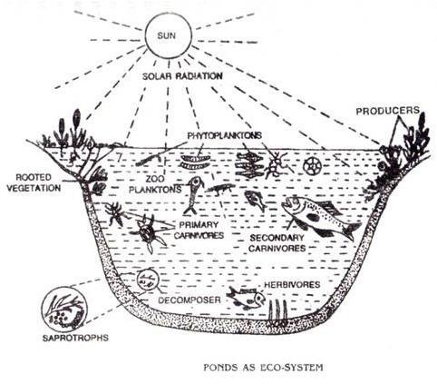
Pond ecosystem
Pond ecosystem is a classical example of ecosystem.

Slide 16
ECOSYSTEM
Food chain: The sequence of eating and being eaten in an ecosystem is known Food chain.
eg. Grass Grasshopper Frog snake hawk
Grassland ecosystem
eg. Phytoplankton water fleas small fish big fish
Pond ecosystem
Trophic level: Position of organism in trophic structure. Depends on nutritious status of that organism.
hawk

Slide 17
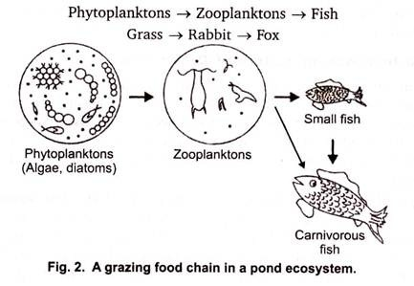
ECOSYSTEM
Types of food chain:
Grazing food chain:
Starts from the living green plant, goes to grazing herbivore, and then to carnivore.
Directly dependent on influence of solar radiation.
eg.

Slide 18
ECOSYSTEM
2. Detritus food chain:
Starts from dead organic matter
Less dependent on solar radiation
Depends chiefly on influence of organic matter generated in another system
eg. Detritus food chain in mangrove ecosystem
Leaf Litter →Saprophytes → algae → Crab → Small fish → Big fish
Saprophytes/ detrivores- Feeds on dead organic matter

Slide 19
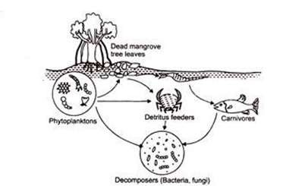
ECOSYSTEM

Slide 20
ECOSYSTEM
Food web: The food web is network of food chains where different type of organisms are connected at different trophic levels, so that there are number of options of eating and being eaten at each trophic level.
eg.

Slide 21
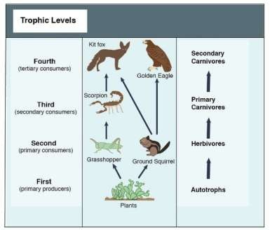
Food web

Slide 22
ECOSYSTEM
Significance of food chain and food web:
Two important functions of energy flow and nutrient cycling take place through them.
Also helps in maintaining and regulating the population size of different animals and thus helps in maintaining the ecological balance.

Slide 23
ECOSYSTEM
Energy flow in the ecosystem/ Ecological energetic:
Sun is basic source of energy
Radiation coming from sun
100%= 10% + 45% + 45%
Total= UV radiation + Infra red + Visible light
Energy reaching to Atmosphere:
100%= 34% + 10% + 56%
Total = reflected back+ Absorbed by Ozone + reaching to earth

Slide 24
ECOSYSTEM
56% is considered as 100% , it is,
1-5% used by green plants for photosynthesis
Remaining is absorbed by ground and water body as heat.
Out of 100% energy coming from sun, only 0.02% used by green plants.
Visible light- 390-760mm
Plants strongly absorbs blue (400-500mm) and red (600-700mm) light

Slide 25
ECOSYSTEM
In ecological energetic we study
Quantity of solar energy reaching to ecosystem
Quantity of energy used by green plants for photosynthesis
The quantity and path of energy flow from producer to consumer

Slide 26
ECOSYSTEM
Energy flow in ecosystem:
Takes place through food chain
Unidirectional or one way flow
Follows two laws of thermodynamics
first law: States that energy can neither be created nor destroyed, but it can be transformed from one form to another.
Second law: Energy dissipates or it gets converted from more concentrated form to dispersed or simple form.

Slide 27
ECOSYSTEM
Energy flow model:( E P Odum, 1956)
Single channel energy flow model
‘Y’ shaped energy flow model

Slide 28
1.Single channel energy flow model
Sun light
118.872 kg cal/cm2/yr
Decomposition (traces)
Decomposition (0.5)
Decomposition (3)
Autotrophs
G.P. 111 gm cal/cm2/yr
Carnivores
G.P. 3
Herbivores
G.P. 15
Respiration (23)
Not utilized
(7)
Respiration (4.5)
Not utilized
(1.2)
Respiration (1.8)
Not utilized
(70)

Slide 29
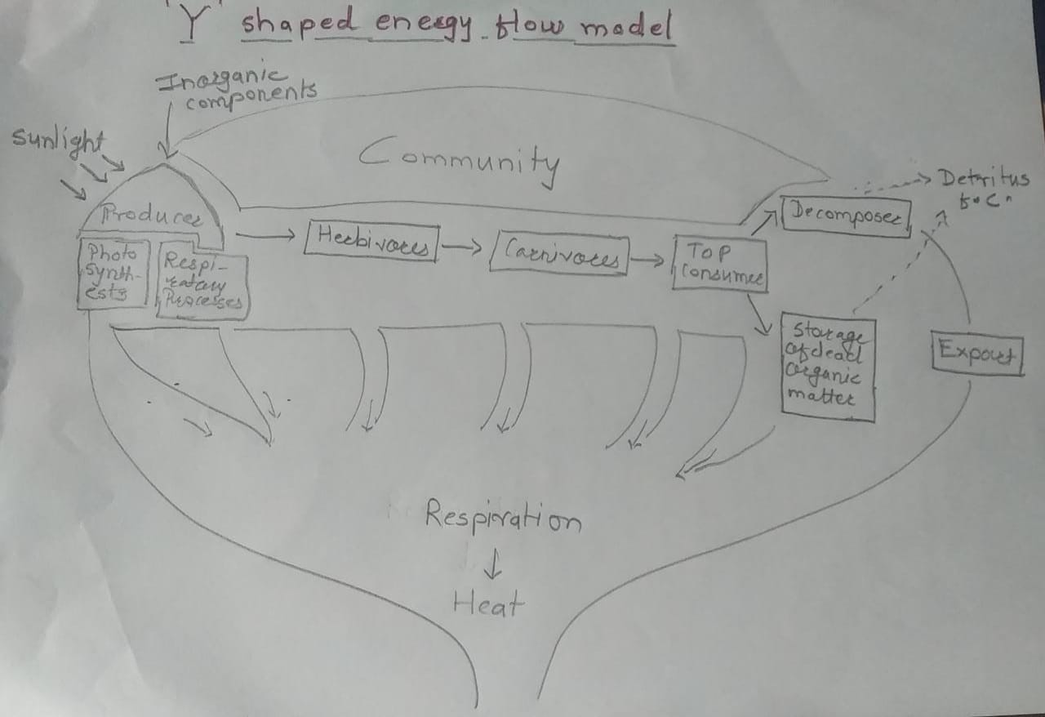
2. ‘Y’ shaped energy flow model

Slide 30
Ecological Pyramid
Definition: Graphical representation of trophic structure and function of an ecosystem, starting with producers at the base and successive trophic levels forming an apex is known as Ecological pyramids. Top consumer
Types:
Pyramid of numbers
Pyramid of biomass producers
Pyramid of energy

Slide 31
1.Pyramid of numbers
Represents number of individual organism at each troplic level in unit area.
We may have upright ( ) or inverted ( ) pyramid of numbers.
eg. Grassland ecosystem ( )
eg. Pond ecosystem ( )
eg. Forest ecosystem ( )
eg. Parasitic food chain ( )

Slide 32
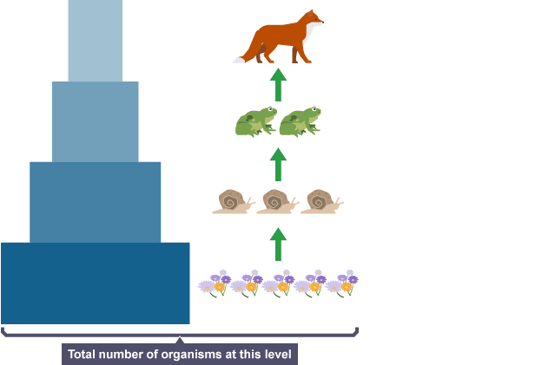
Pyramid of numbers:Grassland ecosystem
Food chain:
Grass →insects → Frog, birds→ Hawk, snake

Slide 33
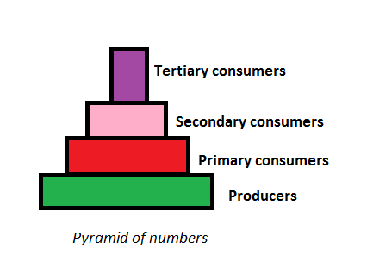
Pyramid of numbers:Pond ecosystem
Algae →Crustaceans → Crab, frog, Small fish → Big fish

Slide 34
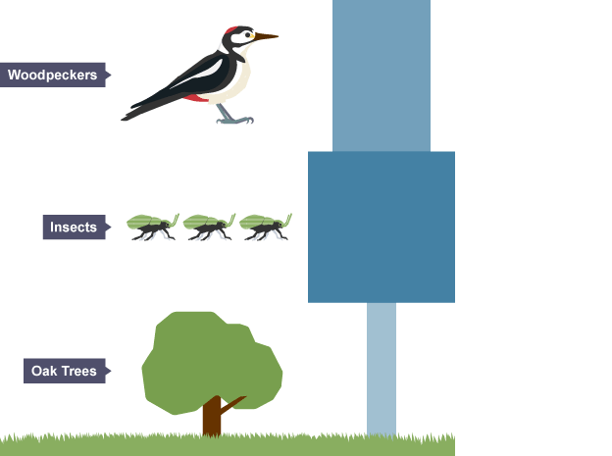
Pyramid of numbers: Forest ecosystem
Big tree →Insects, birds, monkey, squirrel, deer → fox, snake → Lion, tiger

Slide 35
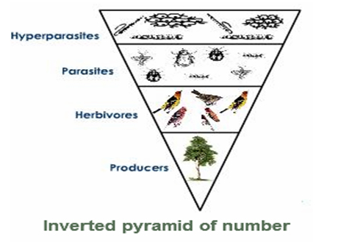
Pyramid of numbers: Parasitic food chain
Single tree →birds → Primary parasite(Bugs,lice) → Hyper parasite (microorganisms)

Slide 36
2.Pyramid of Biomass:
Based on total biomass( body weight) of all organisms at each troplic level in unit area.
We may have upright ( ) or inverted ( ) pyramid of numbers.
eg. Grassland ecosystem ( )
eg. Pond ecosystem ( )
eg. Forest ecosystem ( )
eg. Parasitic food chain ( )

Slide 37
Pyramid of Biomass: Grassland ecosystem, Forest ecosystem, Parasitic food chain
Grass →insects → Frog, birds→ Hawk, snake
Big tree →Insects, birds, monkey, squirrel → fox, snake → Lion, tiger
Single tree →birds → Primary parasite(Bugs,lice) → Hyper parasite (microorganisms)

Slide 38
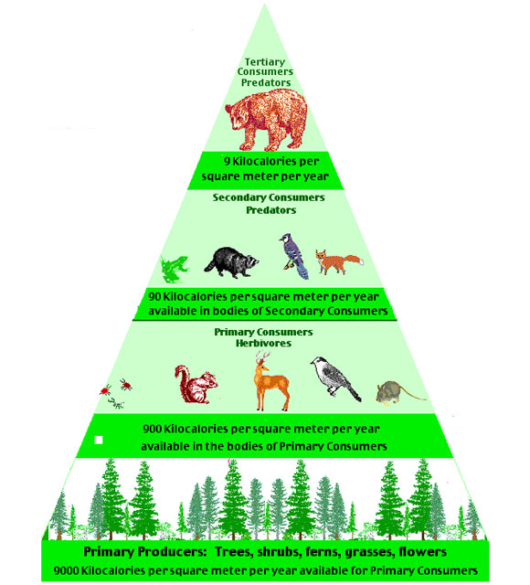
Pyramid of Biomass: Grassland ecosystem, Forest ecosystem, Parasitic food chain

Slide 39
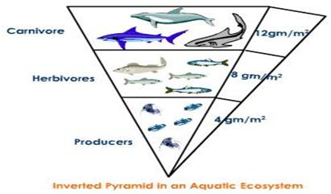
Pyramid of Biomass: Pond ecosystem
Algae →Crustaceans → Crab → Small fish → Big fish

Slide 40
3.Pyramid of Energy:
Based on total amount of energy of all organisms at each troplic level in unit area.
Always upright( )
As we move to successive tropic level there is loss of energy
Energy of producers is always high
Approx. 90% energy is utilized in same trohic level
Approx. 10% energy enters to next trophic level

Slide 41
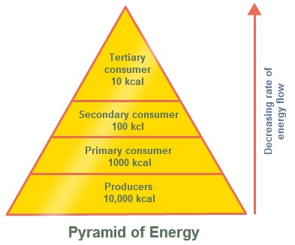
3.Pyramid of Energy:

Slide 42
Ecological Succession/Community Dynamics:
Definition: Ecological succession is defined as, an orderly process of changes in the community structure and function with time and modifications in the physical environment and ultimately reaching in a stabilized ecosystem known as Climax.
eg. Conversion of bare rock into forest
eg. Conversion of pond ecosystem into forest

Slide 43
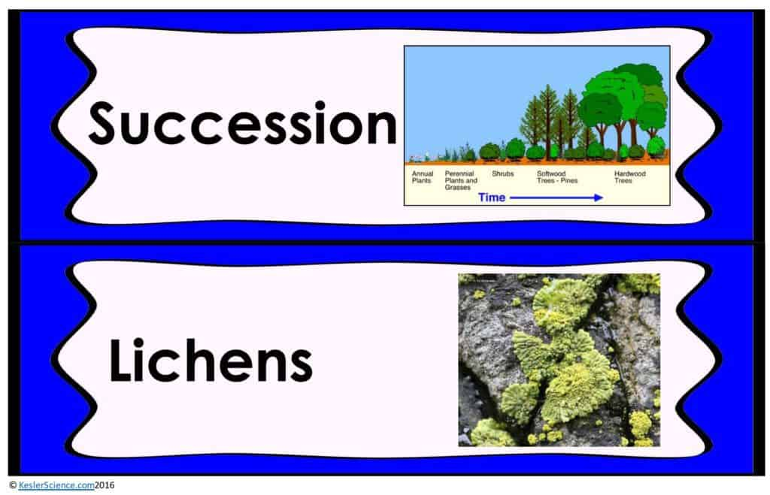
Ecological succession

Slide 44
Ecological succession
Causes of succession
Initial cause or initiative cause
Causes destruction in community and produces bare area
Continuing cause
Causes entry of new community in bare area
Stabilizing cause
Causes stabilization of new community in new area

Slide 45
Ecological succession
Factors responsible for succession
A continuous change in the kinds of plant and animals
An increase in the diversity of species
An increase in the organic matter and biomass supported by the available energy flow
Decrease in net community production or annual yield

Slide 46
Ecological succession
Types of succession:
Primary succession:
Starts with primitive substratum, where there was no previously any sort of living matter.
First group of organism establishing there are known as pioneers or primary colonizer or primary community
eg. Succession started from bare rock
Secondary succession:
Starts with previously built up substratum, with already existing living matter.
Comparatively more rapid
eg. Succession started due to forest fire

Slide 47
Ecological succession
3.Autogenic succession:
After succession has started community itself modifies its own environment by some reaction, thus causing its own replacement by new community.
4.Allogenic succession:
In some cases the replacement of the existing community is caused largely by any other external condition and not by the existing organism.

Slide 48
Ecological succession
5.Autotrophic succession:
Starts with autotrophic organism like green plants.
Begins in inorganic environment (CO2, water, Ca, Mg, etc.)
There is gradual increase in the organic matter content and also in energy content.
There is involvement of both abiotic and biotic factor takes place.

Slide 49
Ecological succession
6.Heterotrophic succession:
Characterized by heterotrophs like bacteria, actinomycetes, fungi, and animals.
Begins with organic environment ( protein, fats, lipids,etc.)
Gradual decrease in organic matter and energy content, as they consume the matter built up by the producers.

Slide 50
Process of Succession:
1. Nudation:
Develops bare area
Factors responsible are
Topographic factor-Landslides, volcanic eruption, etc.
Climatic factor-drought, frosts, glaciers, etc.
Biotic factor-locust, disease outbreak, agricultural and industrial activities etc.

Slide 51
Process of Succession:
2. Invasion
It is entry and successful establishment of one or more species on bare area
Takes place by
Dispersal/migration- Birds, water, wind, etc
Ecesis- seeds, spores germinate, grow
Aggregation- after growth, increase in numbers, forms colony

Slide 52
Process of Succession:
3. Competition and co-action
Competition
Inter-specific (between different species)
Intra-specific(within the same species)
Co-action
Species influence each other in number of ways known as co-action

Slide 53
Process of Succession:
4. Reaction
The living organism grows, use water and nutrient from the substratum and in turn they strongly influence on the environment which gets modified, this is know as reaction.
Reaction leads to several serial communities.
eg. Species of rice, rose

Slide 54
Process of Succession:
5. Stabilization
The terminal community becomes more or less stable for longer period of time and maintains itself in equilibrium, with the climate of the area
Final community is not replaced and is known as climax stage or climax community

Slide 55
Hydro sere/ Hydrarch-conversion of water body in to forest
Stages Process-
Phytoplankton →rooted submerged stage →floating stage →reed swamp stage →sedge meadow stage →woodland stage → Forest stage or climax stage
Stage with Example-
Algae, diatom →hydrilla → lotus, water hyacinth(Echornia) → marshy plants-Polygonum, Ipomoea, Marsilea, → grasses → herbs → shrubs → big trees

Slide 56
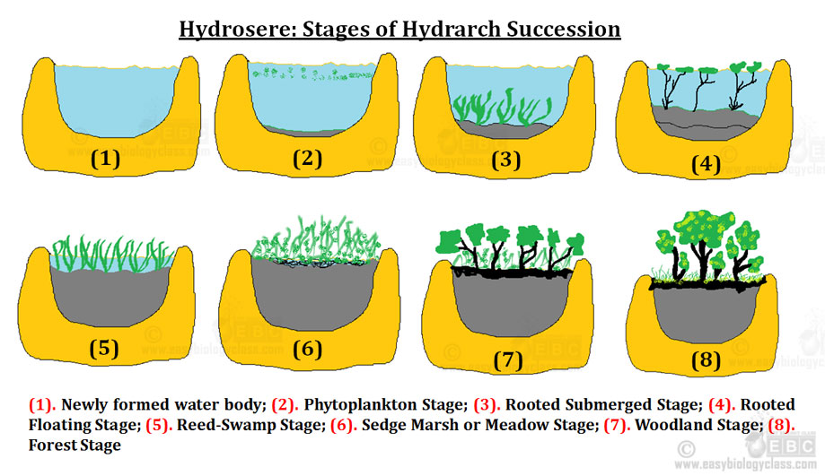

Slide 57
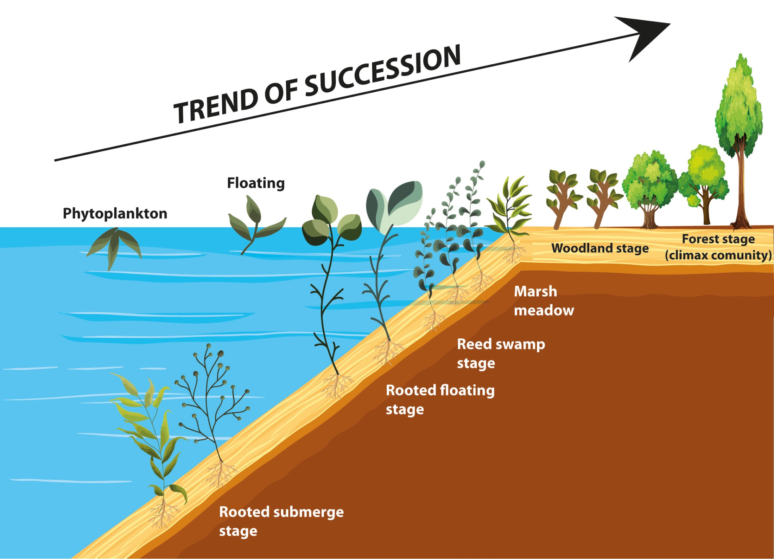

Slide 58
Major ecosystems of the world
Forest ecosystem
Grassland ecosystem
Desert ecosystem
Aquatic ecosystem
Fresh water ecosystem
Salt water ecosystem

Slide 59
Forest Ecosystem
1. Boreal coniferous forest/ evergreen coniferous forest
Great north woods
Lie between 45 degree North and 57 degree north
Climate- Cool, great precipitation in summer
Soil acidic and mineral deficient
Prominent trees- White spruse, Balsom fur, Pine, Kedar, etc.
Species diversity is less

Slide 60
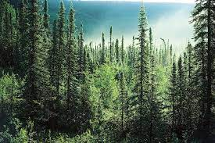
Boreal coniferous forest

Slide 61
Forest Ecosystem
2. Temperate deciduous forest:
Observed in Eastern North America, entire Europe, part of Japan, Australia, some part of South America
Evenly distributed rainfall (80-100 inches/yr)
Represents one of the most important biotic region
‘White men civilization’ developed in this region
Biome is highly modified by men
Plants produces pulpy fruits and nuts, oak, Maple tree
Animal observed are deer, bear, squirrel, gray fox, wood peaker, etc.

Slide 62
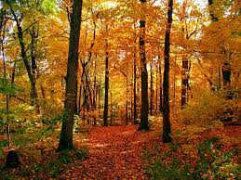
Temperate deciduous forest

Slide 63
Forest Ecosystem
3. Temperate evergreen forest:
Observed in North America, Spain, Australia
Dry summers and cool moist winters
Low evergreen trees with broader leaves or hard needle
Plants are well developed and follow quick regeneration
Animal obeserved mule deer, brush rabbit, wood rats and lizards

Slide 64
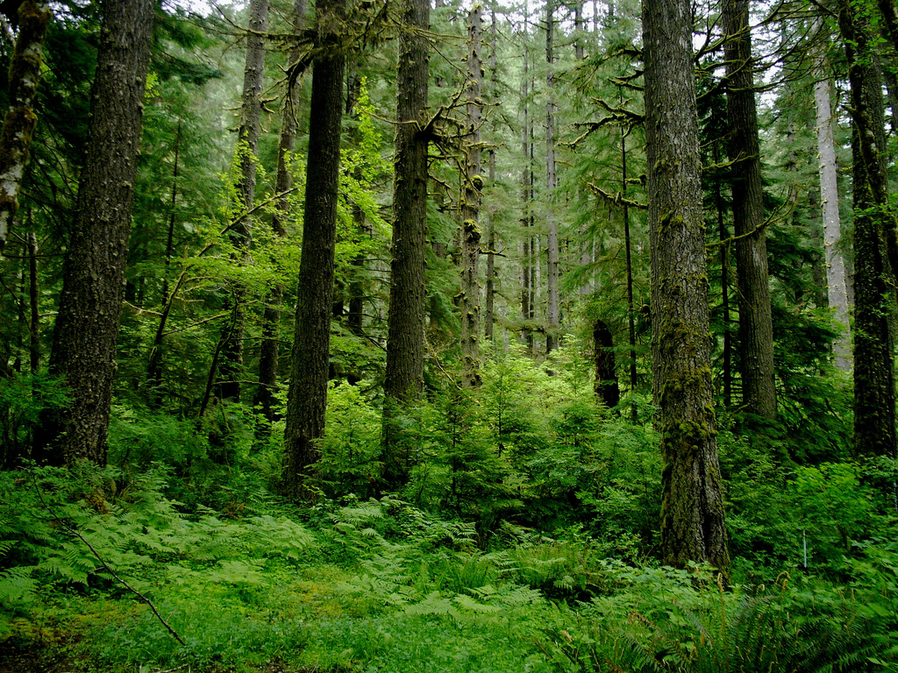
Temperate evergreen forest

Slide 65
Forest Ecosystem
4. Tropical rain forest:
Evergreen, broad leaf forest found near equator
Characterized by high temperature, high humidity and high rain fall.(80-90 inches/yr. rain fall) which favors the growth of trees
For whole year the climate remains more or less same
Rich in biodiversity
eg. Amazon forest, Indian forest- silent valley in Kerala

Slide 66
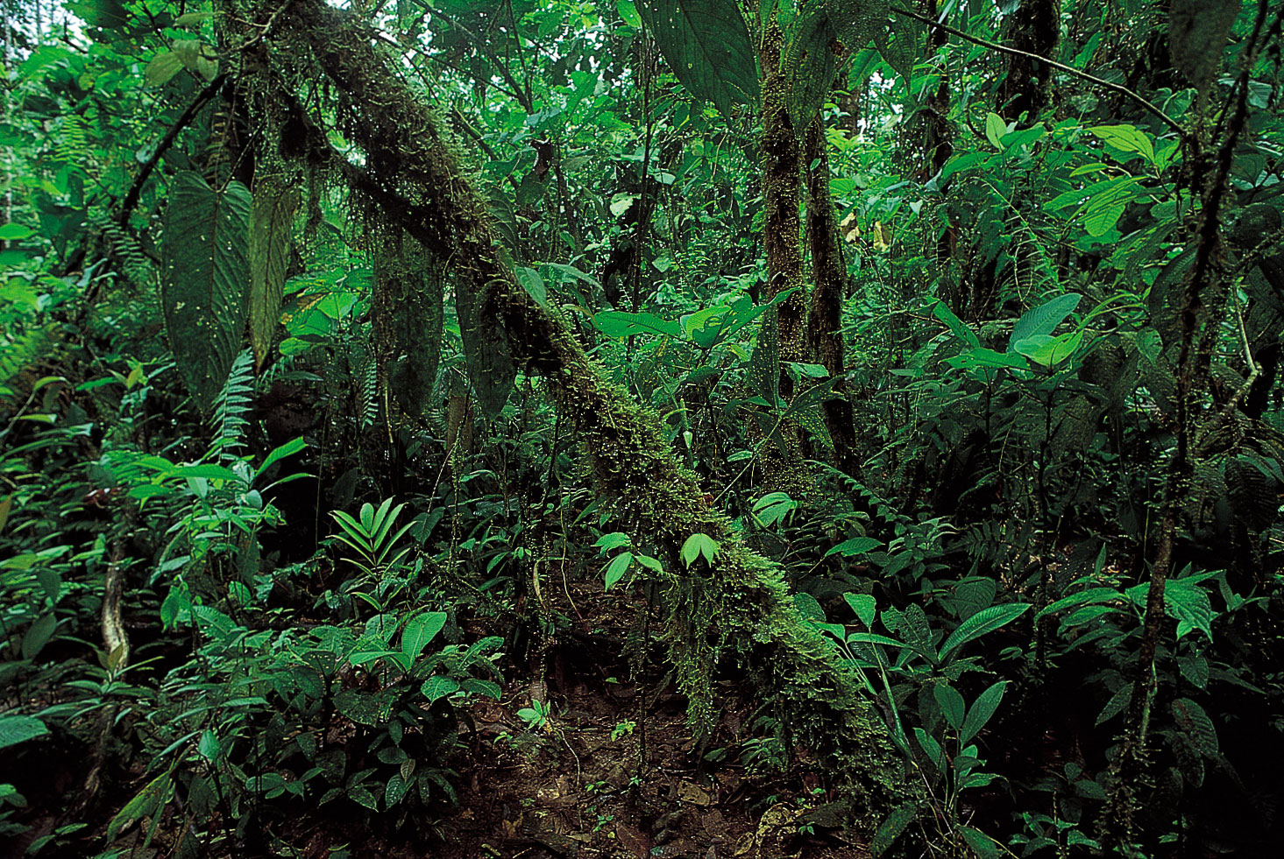
Tropical rain forest

Slide 67
Forest Ecosystem
5.High altitude or alpine forest:
High altitude environment
Low air density high ozone content, low oxygen and carbon-dioxide, high wind velocity, cold and snow
Alpine zone exists at height 3600 mtr.
Invertebrates occur in lake, stream and ponds
Among vertebrates fish, amphibians and reptiles are greatly observed
eg. Snow leopard, Tibetan yak, Tibetan sheep, crow and Persian wild goat

Slide 68
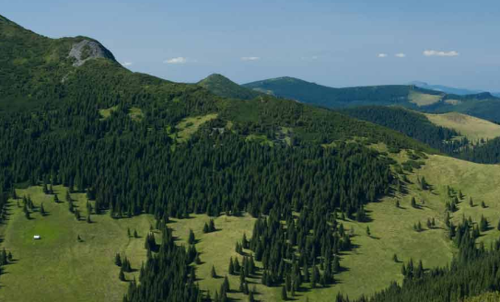
High altitude or alpine forest

Slide 69
Grassland ecosystems
Rain fall is average but erratic
Dominated by grass species but some times allows growth of few trees and shrubs
Limited grazing helps to improve the primary production of grass land but over grazing leads to degradation of these grass land and results in desertification
Soil contains large amount of humus
Major food plants are grasses like rice, wheat, maize, etc.
Grass lands are known by different name in different region like in north America-prairie, in Europe-Steppes in Africa-African veldt and savannah, in South America-pampas, in India-pastures
Apart from grasses different animals are found in different regions of grass land like Zebra, Giraffe. Termites are found in colonies forming moulds
Depending upon the height of grass there are three types of grasses

Slide 70
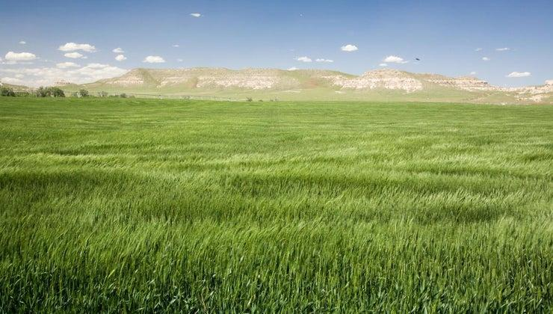
Grassland ecosystems

Slide 71
Types of Grasses
1. Tall grass: Height ranges from 5 to 8 feet
eg. Indian grass, slough grass, switch grass, big blue stem, bamboo, sugar cane etc.
2. Mid grass: height 2 to 4 feet
eg. Needle grass, drop seed, western wheat grass, tune grass, Indian rice grass etc.
3. Short grass: grows maximum up to 1.5 feet
eg. Buffalo grass, blue grass

Slide 72
Desert ecosystems
Annual rain fall less than 50 cm./ per yr.
1/3 off worlds land is covered by desert
Biodiversity is less consists of drought resistant or drought avoiding plants
Soil is nutrient rich but water deficient
Major adaptation is for conservation of water
Leaves are scaly or succulent
Stem is developed and forms chlorophyll
Deep rooted to tap ground water
Animals includes insects and reptiles
Thick outer covering or covered with scales, lives in burrow

Slide 73
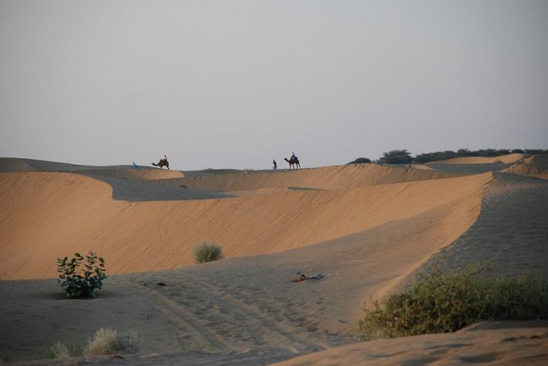
Desert ecosystems

Slide 74
Types of deserts
a. Tropical desert- high day time temperature
eg. Sahara and Namibia in Africa and Thar desert in Rajasthan
b. Temperate desert- day time temperature is very hot in summer but cold in winter
eg. Mojave in Southern California
c. Cold desert-cold winter and warm summers
eg. Gobi desert in China

Slide 75
4.Aquatic ecosystem
Aquatic ecosystem
Fresh water
Salt water

Slide 76
4.Aquatic ecosystem
Fresh water
Lentic (Standing water)
Lake
Pond
Impoundment
Lotic (Flowing water)
River
Stream

Slide 77
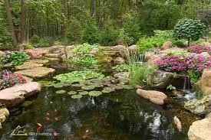
4.1 Fresh water ecosystem
Pond ecosystem- Shallow water body, may seasonal. Quite productive due to accumulation of organic matter. Often used by man, so gets polluted.

Slide 78
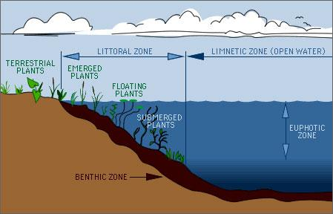
4.1 Fresh water ecosystem
b. Lake ecosystem- Big in size, divided in 3 zones-Littoral zone, Limnetic zone and profundal zone

Slide 79
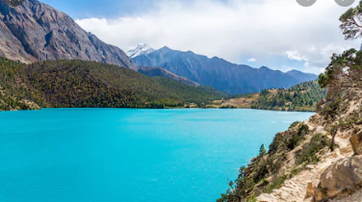
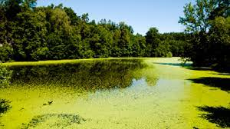
4.1 Fresh water ecosystem
Types of lake-
Oligotrophic lake-
Eutrophic lake

Slide 80
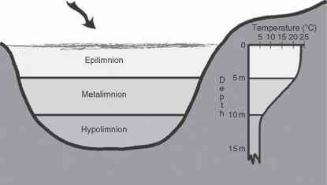
1.Oligotrophic lake
Deep with hypolimnion layer ( cold viscous non circuiting bottom layer) larger than epiliimnion layer (warm circulating surface layer). Less productive, so less nutrient concentration.

Slide 81
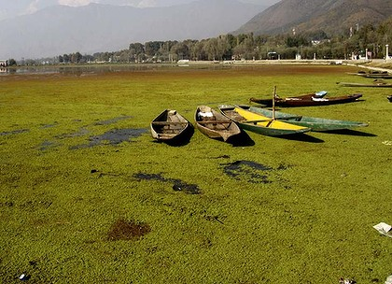
2.Eutrophic lake
Shallower and high nutrient content. Over nourished by nutrients like nitrogen and phosphorous. Covered with algal bloom.
eg. Dal lake, Ulhar lake in Kashmir

Slide 82
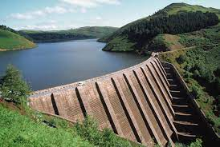
4.1 Fresh water ecosystem
Impoundment/ reservoir
Artificial water body. Fluctuating water level and high turbidity. Built to store and release of water in controlled manner for hydraulic project or irrigation, etc.

Slide 83
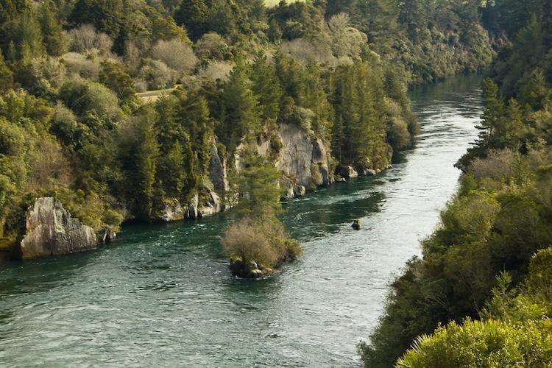
4.1 Fresh water ecosystem
River ecosystem- Running water, high oxygen, but ecosystem is less developed because of flowing water current.

Slide 84
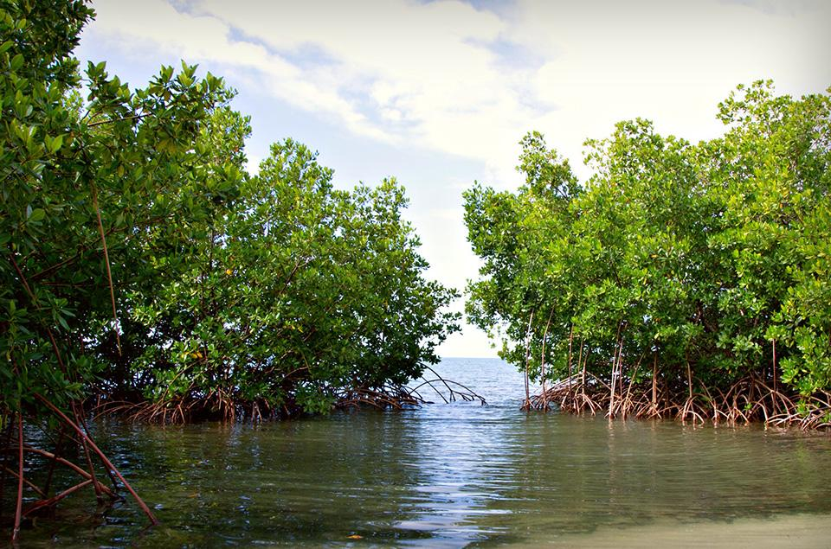
4.2 Salt water ecosystem
Estuarine ecosystem

Slide 85
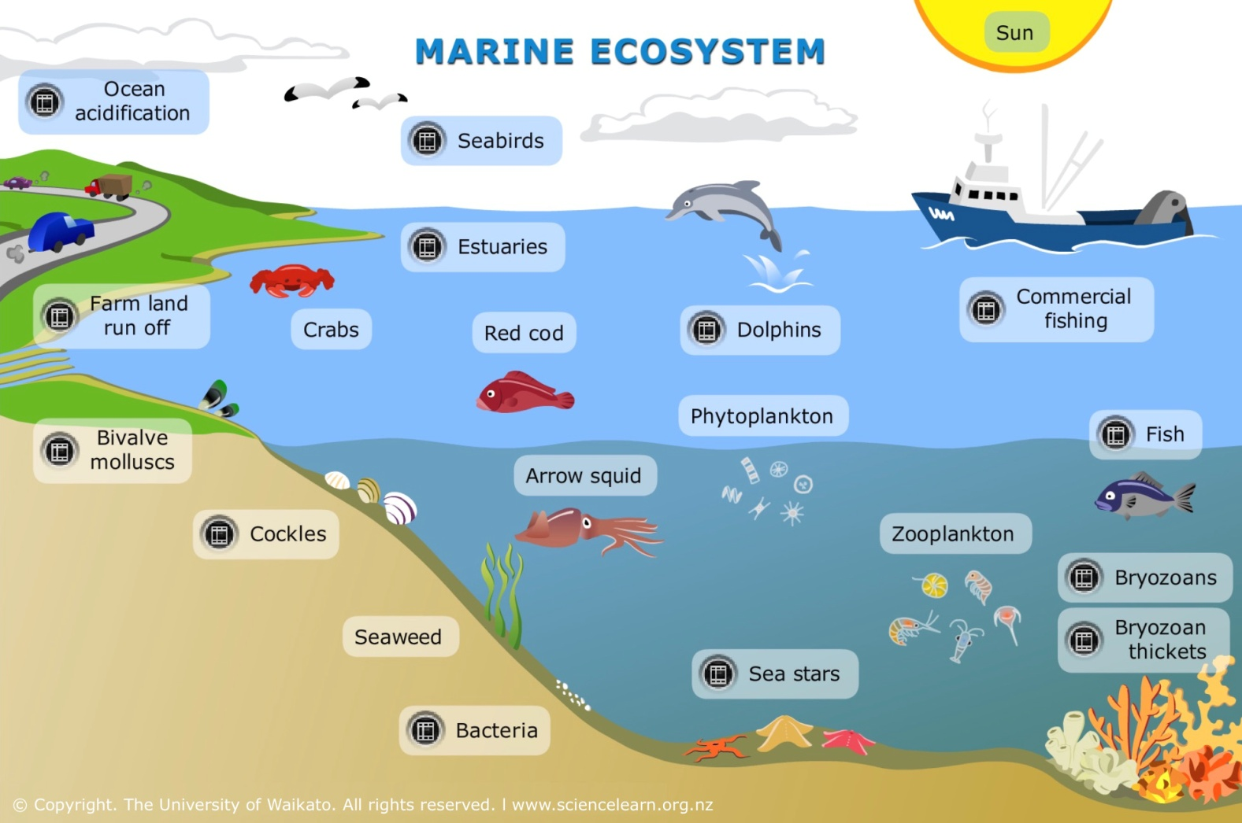
4.2 Salt water ecosystem
Marine ecosystem

